Slide 1
Today’s Lecture
Object passed to the function
Object as a return type
Operator overloading

Slide 2
Object passed to the function
Objects of class can also be passed as parameters in member functions. The same method of passing as in user-defined functions

Slide 3
main.cpp
// object passed to the function
obj3.calculation_marks(obj1, obj2);
cout << "\n";
system("pause");
#include<iostream>
#include "Header.h"
using namespace std;
int main()
{
student obj1, obj2, obj3;
obj1.set_name("Umer Arshad");
obj1.set_marks(66);
obj2.set_name("Hassan");
obj2.set_marks(86);
obj1.get_name();
obj1.get_marks();
obj2.get_name();
obj2.get_marks();
}

Slide 4
Header.h
char* get_name();
int get_marks();
void calculation_marks(student& object_1, student& obj2);
};
#pragma once
class student {
private:
char* name;
int marks;
public:
// Object passed to the function understand
student();
char set_name(const char * n);
int set_marks(int M);

Slide 5
(Source1.cpp)
char* student:: get_name()
{
return name;
}
int student::get_marks()
{
return marks;
}
void student::calculation_marks(student& object_1, student& object_2)
{
double get_marks;
cout << " Object 1 Student name is: " << object_1.name << endl;
cout << " Object 1 marks is: " << object_1.marks << endl;
cout << " Object 2 Student name is: " << object_2.name << endl;
cout << " Object 2 marks is: " << object_2.marks << endl;
get_marks = object_1.marks + object_2.marks;
cout << " Both Student Objects marks are: " << get_marks;
}
#include "Header.h"
#include<string>
#include<string.h>
#include<iostream>
using namespace std;
// Object passed to the function
student::student()
{
}
char student::set_name(const char* n)
{
int length = strlen(n);
name = new char[length + 1];
for (int i = 0; i < length; i++)
{
name[i] = n[i];
}
name[length] = '\0';
return *name;
}
int student::set_marks(int M)
{
marks = M;
return marks;
}

Slide 6
Object as a return type (main.cpp)
#include<iostream>
#include"Header.h"
using namespace std;
int main()
{
// object as a return type
student obj1, obj2, obj3;
obj1.set_name("Umer Arshad");
obj1.set_marks(60);
obj2.set_name("Hassan");
obj2.set_marks(90);
obj1.get_name();
obj1.get_marks();
obj2.get_name();
obj2.get_marks();
obj3 = obj3.calculation_marks(obj1, obj2);
obj3.display();
cout << "\n";
system("pause");
}

Slide 7
(Header.h)
char set_name(const char * n);
int set_marks(int M);
char* get_name();
int get_marks();
void display();
student calculation_marks(student& object_1, student& obj2);
};
#pragma once
class student {
private:
char* name;
int marks;
public:
// Object as a return type
student();

Slide 8
(source1.cpp)
get_marks.marks = object_1.marks + object_2.marks;
return get_marks;
}
void student::display()
{
cout << " Both student mark are: " << marks << endl;
}
int student::set_marks(int M)
{
marks = M;
return marks;
}
char* student:: get_name()
{
return name;
}
int student::get_marks()
{
return marks;
}
student student::calculation_marks(student& object_1, student& object_2)
{
student get_marks;
cout << " Object 1 Student name is: " << object_1.name << endl;
cout << " Object 1 marks is: " << object_1.marks << endl;
cout << " Object 2 Student name is: " << object_2.name << endl;
cout << " Object 2 marks is: " << object_2.marks << endl;
#include "Header.h"
#include<string>
#include<string.h>
#include<iostream>
using namespace std;
// Object passed to the function
student::student()
{
}
char student::set_name(const char* n)
{
int length = strlen(n);
name = new char[length + 1];
for (int i = 0; i < length; i++)
{
name[i] = n[i];
}
name[length] = '\0';
return *name;
}

Slide 9
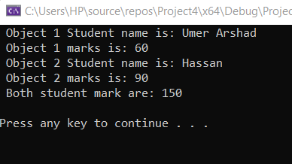
Output of the following program

Slide 10
Class Activity
Private Members | Type
Km (kilometers), hr (hours) | Integer
Public Member:
Travel() ( default constructor initializes both members to 0). | none
Input() Detail: takes inputs from user | void
displaydata() Detail: Function to display the data members on the screen | Void
Sum(object as parameter) Detail: that takes an object as parameter of type as class and adds kilometers and hours of calling object and the parameter and displays values. | void

Slide 11
Class Activity 2
Private Members | Type
hrs(hours), min(minutes) | Integer
Public Member:
Time() ( default constructor initializes both members to 0). | none
TInput() Detail: takes inputs as minutes and hours from user | void
displaydataT() Detail: Function to display the data members on the screen | Void
time sum(time) Detail: that takes an object as parameter of type as class and adds to sum two-time object & return time) . | void

Slide 12
Operator Overloading (Binary Operator)
Operator overloading is an important concept in C++. It is a type of polymorphism in which an operator is overloaded to give user-defined meaning to it
An operator which contains two operands to perform a mathematical operation is called the Binary Operator Overloading.
It is a polymorphic compile technique where a single operator can perform various functionalities by taking two operands from the programmer or user.
There are multiple binary operators like +, -, *, /,%, etc., that can directly manipulate or overload the object of a class.

Slide 13
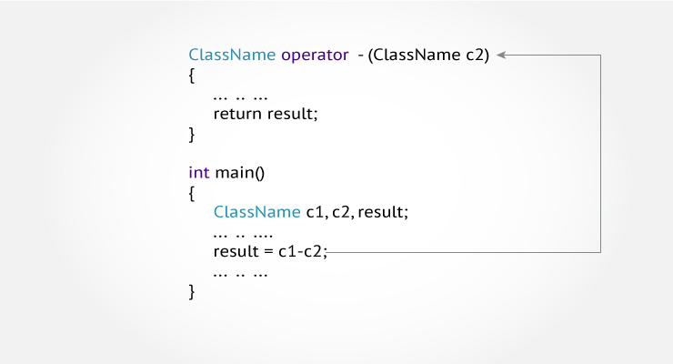
Operator Overloading

Slide 14
Operator Overloading (+) (main.cpp)
object2.get_name();
object2.get_id();
// Operator Overloading Concept
student object3 = object1 + object2;
object3.display();
cout << "\n";
system("pause");
}
#include<iostream>
#include "Header.h"
using namespace std;
int main()
{
student object1, object2;
char* nam, *na;
nam = new char;
na = new char;
int idd, id2;
cout << "Enter your name: ";
cin.getline(nam, 30);
cout << " Enter student ID: ";
cin >> idd;
cout << "Enter your name: ";
cin.ignore();
cin.getline(na, 30);
cout << " Enter student ID: ";
cin >> id2;
object1.set_name(nam);
object1.set_id(idd);
object2.set_name(na);
object2.set_id(id2);
object1.get_name();
object1.get_id();

Slide 15
Operator Overloading (+) (Heaer.h)
#pragma once
class student {
private:
char* name;
int id;
public:
student();
char set_name(const char* n);
int set_id(int ID);
char* get_name();
int get_id();
void display();
student operator+(student& others);
};

Slide 16
Operator Overloading (+) (Source1.cpp)
student student::operator+(student& others)
{
student save_data;
cout << " Current Student name is: " << name << endl;
cout << " Current Student id is: " << id << endl;
cout << " Current Student name is: " << others.name << endl;
cout << " Current Student id is: " << others.id << endl;
save_data.id = id + others.id;
return save_data;
}
void student::display()
{
cout << " Addition of both id is: " << id;
}
#include "Header.h"
#include<string>
#include<string.h>
#include<iostream>
using namespace std;
student::student()
{
}
char student::set_name(const char* n)
{
int len = strlen(n);
name = new char[len + 1];
for (int i = 0; i < len; i++)
{
name[i] = n[i];
}
name[len] = '\0';
return *name;
}
int student::set_id(int ID)
{
id = ID;
return id;
}
char* student::get_name()
{
return name;
}
int student::get_id()
{
return id;
}

Slide 17
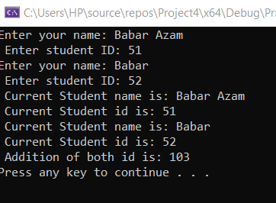
Output

Slide 18
Class Activity
Write a C++ program that initially takes the length of the two matrixes from the user and puts the values in both matrixes, then performs addition using the operator overloading concept

Slide 19
Operator Overloading (+) (Header.h)
#pragma once
#include<iostream>
using namespace std;
class matrix_addition {
private:
int rows, cols;
public:
int** twodarr;
int** save_data;
public:
matrix_addition() {
}
int set_rows()
{
cout << " Enter the number of rows: ";
cin >> rows;
return rows;
}
int set_cols()
{
cout << " Enter the number of column: ";
cin >> cols;
return cols;
}
void set_data()
{
twodarr = new int* [rows];
for (int i = 0; i < rows; i++)
{
twodarr[i] = new int[cols];
}
for (int i = 0; i < rows; i++)
{
for (int j = 0; j < cols; j++)
{
cin >> twodarr[i][j];
}
}
}
void show_data()
{
for (int i = 0; i < rows; i++)
{
for (int j = 0; j < cols; j++)
{
cout << twodarr[i][j];
cout << "\t";
}
cout << endl;
}
}

Slide 20
Operator Overloading (+) (Header.h)
void operator +(matrix_addition& other)
{
save_data = new int* [rows];
for (int i = 0; i < rows; i++)
{
save_data[i] = new int[cols];
}
for (int i = 0; i < rows; i++)
{
for (int j = 0; j < cols; j++)
{
save_data[i][j] = twodarr[i][j] + other.twodarr[i][j] ;
cout<< save_data[i][j];
cout << "\t";
}
cout << endl;
}
}
};

Slide 21
Operator Overloading (+) (Source.cpp)
#include<iostream>
#include "Header.h"
using namespace std;
int main()
{
matrix_addition obj1, obj2;
obj1.set_rows();
obj1.set_cols();
obj2.set_rows();
obj2.set_cols();
obj1.set_data();
obj2.set_data();
obj1.show_data();
cout << endl;
obj2.show_data();
cout << endl;
obj1 + obj2;
cout << "\n";
system("pause");
}

